Slide 1
Deadline for homework and project reports: 12-9-16
Quiz #4 given 1-3pm Wednesday 12-14-16
Covers material in lectures since quiz3
MLP
RBF-ANN
Clustering
SOM
SVM
Intent of this review is to focus study for quiz #4
Questions will be posted on class web page.
Answers can be found in lecture slides.

Slide 2
Question on ANN

Slide 3
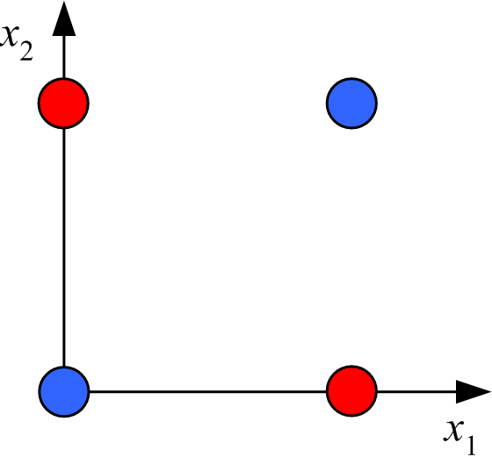
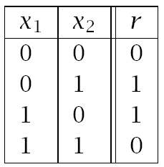
Review: Boolean XOR: linearly inseparable 2D binary classification problem
data table
graphical representation
Both the Gaussian feature space and ANN have the same strategy for solving
this problem. What is that strategy?

Slide 4
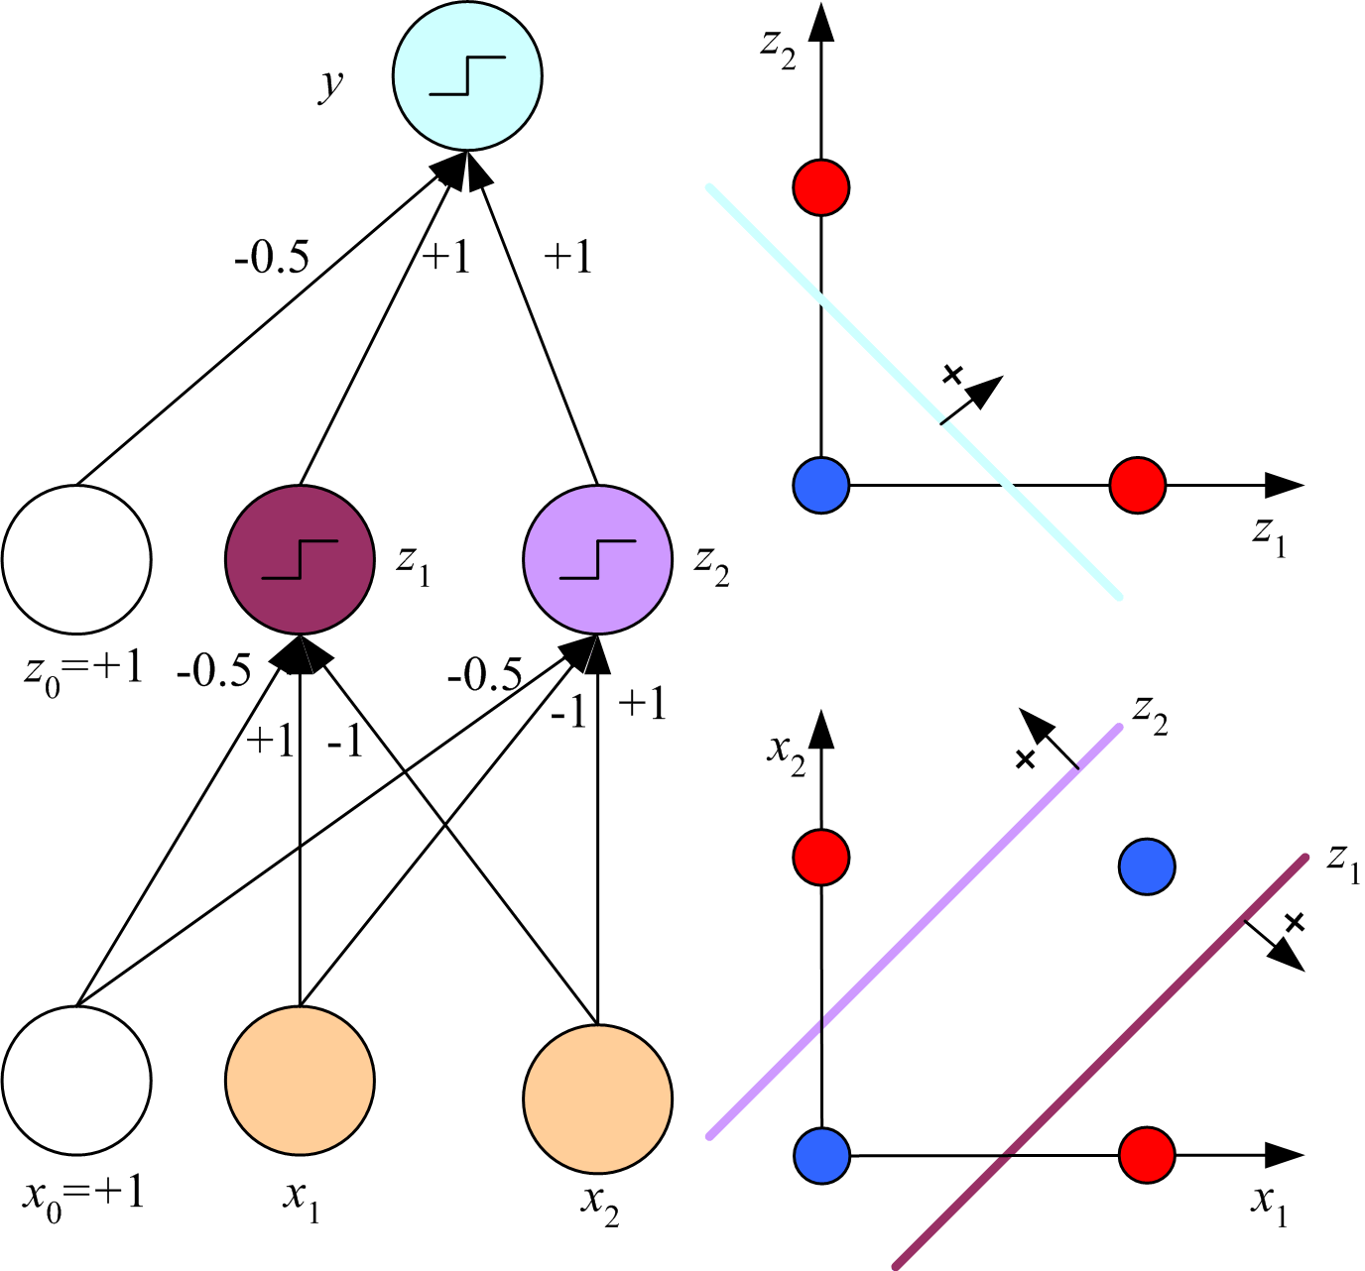
Solution to XOR classification problem by MLP
S
S means that input to a node
has been transformed by the
sigmoid function.
For hidden nodes z₁ and z₂
this means z_{h} = sigmoid(w_{h}^{T}x).
If z_{h} is to be approximately
equal to r for point (0,0) and
(1,1), how do we design w_{h}
to achieve this objective?
-0.78
S
S
4

Slide 5
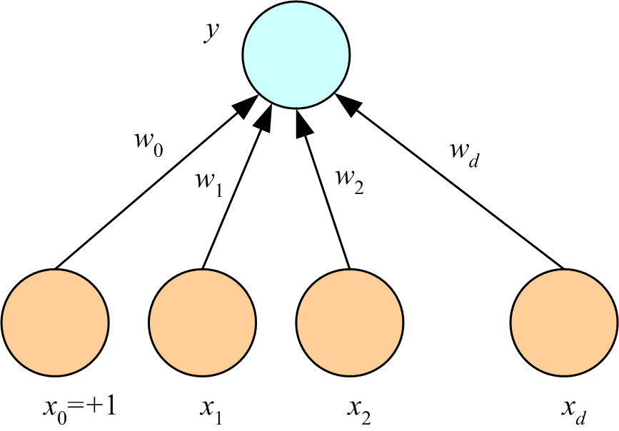
Weights optimized by back propagation
Simplest case: multivariate linear regression
In-sample error is squared residuals and no hidden layers
Derive the weight update formula using
and

Slide 6
How do “batch” weight-update formulas differ from “on line” formulas?
After optimum weights have been determined, how so you use an MLP
to make a prediction?
What is a “training epoch?

Slide 7
How is a validation set used in the technique “stop early to avoid overfitting”?

Slide 8
Question on Radial basis functions-ANN and Clustering

Slide 9
For regression or classification after binning, weights in a RBF-ANN can be obtained by
“one-step optimization. Explain how this is possible.

Slide 10
K-means clustering is an example of maximum-likelihood parameter estimation by
iterative Expectation-Maximization (EM).
What parameters are being estimated?
What happens on an E-step?
What happens on a M-step?

Slide 11
RBF-ANN uses K-means clustering.
How are the parameters of the Gaussian basis functions calculated?

Slide 12
Describe agglomerative clustering with single linkage.

Slide 13
Question on Self Organizing Maps

Slide 14
What is the basic objective of self organizing maps?

Slide 15
What are the 3 aspect of training in a SOM algorithm?

Slide 16
How does a contextual map differ from a semantic map as SOM output?

Slide 17
What does the UMAT output add to Sematic map output?

Slide 18
How does a UMAT enable definition of “stars”?

Slide 19
What do “stars” add to a UMAT output?

Slide 20
As a clustering method, what is the main advantage of SOM?

Slide 21
Questions on support vector machines

Slide 22
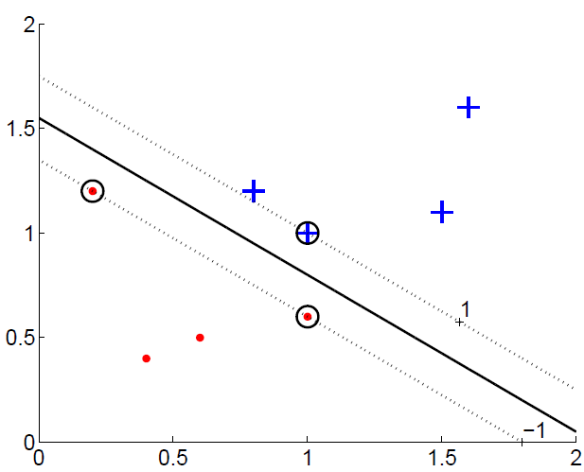
Why is maximizing margins a good strategy for classification?
Separating hyperplane
Support vectors
margins
Lecture Notes for E Alpaydın 2010 Introduction to Machine Learning 2e © The MIT Press (V1.0)
22

Slide 23
In L_{p}, which variables are primal and which are dual?
How does L_{p} get changed into L_{d}; shown below with only dual variables?

Slide 24
What is the “active set” in constrained optimization?
How does maximization of the dual make constraints on
support vectors the active set?

Slide 25
Maximize
Set α^{t} = 0 for data point sufficiently far from discriminant to be ignored in the search for hyperplane with maximum margins.
Find remaining a^{t} > 0 by quadratic programing
Given the a^{t} > 0 that maximize L_{d} calculate
What is the dimension of w?
How do you find a value for w₀?
Lecture Notes for E Alpaydın 2010 Introduction to Machine Learning 2e © The MIT Press (V1.0)
25

Slide 26
In constrained optimization, constraints are placed on primal variables,
for example:
maximize
L_{d} does not contain any primal variables.
What are the origins of the constraints placed on its maximization?

Slide 27
In the equation for Lp below, which variables are primal and which are dual?
Does L_{p} contain any parameters? If so, what is their purpose?

Slide 28
The components of soft error =
have the form of “hinge loss”
xt with rt = 1 is correctly classified but in the margins. What are the bounds on hinge loss?
xt with rt = 1 is misclassified. (a) What are the bounds on hinge loss if xt is in the margins? (b) What are the bounds on hinge loss if xt is outside of the margins?

Slide 29
How does the value of regularization parameter C effects binary
classification by SVM with slack variables?

Slide 30
The L_{p} for ν-SVM, with constraints included, is shown below.
What are the primal variables? What are the dual variables
Does it contain any parameters? If so, what is their purpose?

